Slide 1

RECOGNITION OF PRIOR LEARNING
FETC: Road Traffic Law Enforcement , NQF Level 4
SAFETY AND SECURITY / METRO POLICE TRAINING ACADEMY

Slide 2

INTRODUCTION
The Metropolitan Police Training Academy has embarked on a Recognition of Prior Learning (RPL) Programme for the FETC: Road Traffic Law Enforcement , NQF Level 4 qualification on the 29 January 2024.
We have 1183 candidates enrolled for the RPL Programme. The RPL Programme is implemented in two phases. Currently the RPL Phase 1 has been rolled out to 392 members from different units: Facilitators, Traffic Services and Law Enforcement.

Slide 3

RTMC RPL POLICY REQUIREMENTS
The minimum requirements for entry into the RPL program is:
The targeted categories must be full time employees with at least three (3) years’ experience in the Road Safety, Traffic Management or Law Enforcement environment. Proof of employment in the form of a letter from the employer or a sworn affidavit must be furnished.
South African Citizen (Copy of SA ID Required)
Code B driving licence (manual transmission)
No criminal record

Slide 4

RPL WORKSHOP
The RPL workshops are an essential part of the RPL project as they provide orientation, guidance and support to the candidates. The workshops are conducted by RPL facilitators who explain the purpose, benefits and expectations of the RPL process.

Slide 5

RPL WORKSHOP
The candidates who meet the requirements are invited to attend a workshop where they receive information about the RPL process, specific criteria for implementation of RPL, Quality assurance of implementation of RPL, Methods of assessment, assessment criteria, complaints and appeals, and support services. They also complete the Annexure B (Unit standards), which breaks down the qualification into the Fundamentals, Core and Electives that guides them to identify their strengths and gaps in relation to the qualification outcomes.

Slide 6

RPL CATEGORIES
The categories are based on the different roles and responsibilities of the candidates within the road traffic law enforcement sector. Each category has specific assessment criteria and portfolio requirements that reflect their scope of work and experience. The categories are:

Slide 7
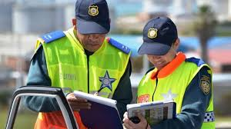
RPL CATEGORIES
Traffic wardens: They are responsible for enforcing parking regulations and issuing fines for parking offences. They also assist with traffic control and road safety awareness campaigns. Their portfolio must include evidence of their knowledge and skills in traffic legislation, communication, customer service, conflict resolution and administration.

Slide 8
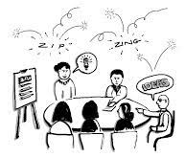
RPL CATEGORIES
Facilitators at training centres with minimum of 3 years’ experience in Law Enforcement: They have been trained and certified as SAPS Officials. They are responsible for facilitating learning and assessment programmes for traffic wardens and law enforcement officers at the training centres. Their portfolio must include evidence of their knowledge and skills in road traffic law enforcement, traffic legislation, communication, customer service, conflict resolution, administration, operational procedures, facilitation, assessment and moderation.

Slide 9
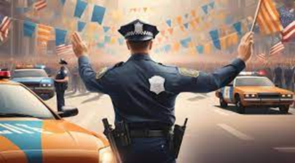
RPL CATEGORIES
Law Enforcement Officers: They are responsible for enforcing road traffic laws and regulations and issuing fines for traffic offences. They also do crime prevention and community policing. Their portfolio must include evidence of their knowledge and skills in road traffic law enforcement, traffic legislation, communication, customer service, conflict resolution, administration and operational procedures.

Slide 10
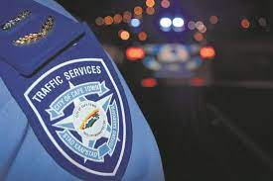

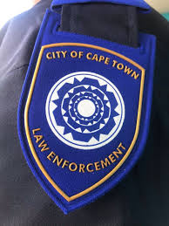
TABLE OF THE CATEGORIES
CATEGORY | RPL WORKSHOP ATTENDEES | APPLICATIONS | ELIGIBLE
Traffic Wardens | 26 | 32 | 26
Facilitators at Training Centres (With a minimum of 3 years’ experience in the Law Enforcement Environment ) | 10 | 10 | 10
Law Enforcement Officers | 1180 | 1350 | 1147
Totals | 1216 | 1392 | 1183

Slide 11

RPL ADVISING
The RPL advising is a support service that is available to the candidates throughout the RPL process. The RPL advisors provide individual counselling to the candidates on various aspects of the RPL process, such as:
Clarifying the RPL requirements and expectations
Identifying and selecting appropriate evidence for the portfolio
Organising and presenting the portfolio
Dealing with feedback
The RPL advisors can be contacted by email, Skype or in person at the RPL office at the Metropolitan Training Centre.

Slide 12
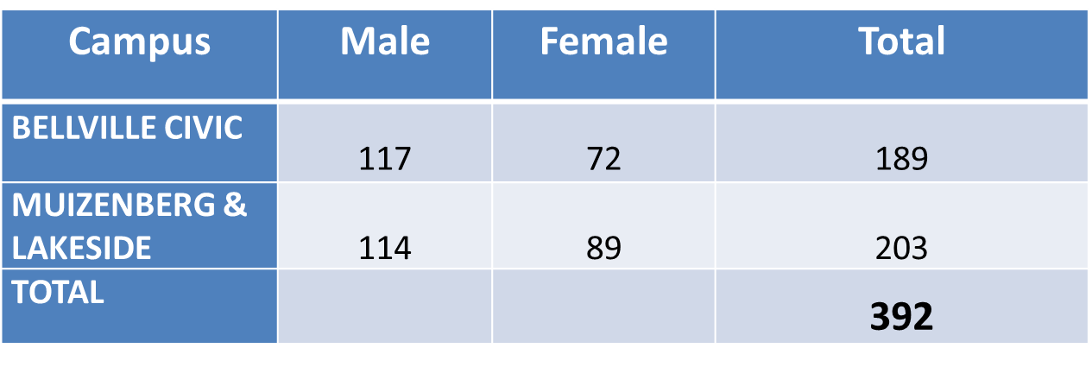
RPL PHASE 1: CANDIDATES

Slide 13
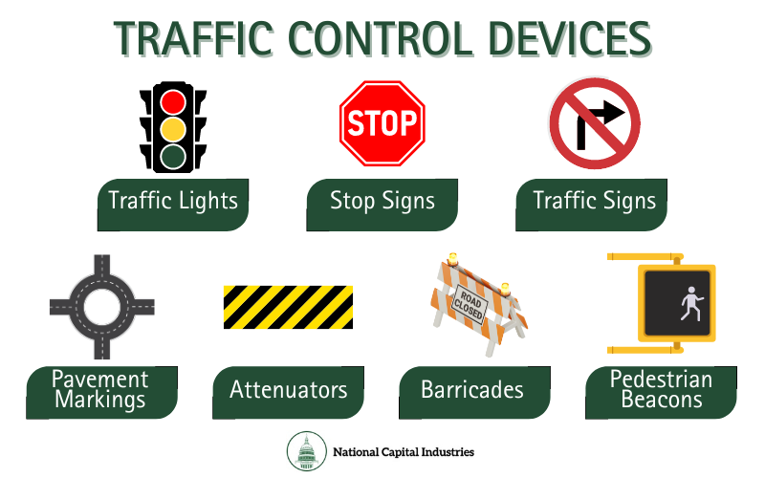
STATUS OF RPL PHASE 1
The RPL Phase 1 group has completed the theoretical phase, and will thereafter commence with the practical phase, which is control traffic.

Slide 14
FINAL INTEGRATED SUMMATIVE ASSESSMENT
The FISA for the RPL Phase 1 group will be written on the:

Slide 15
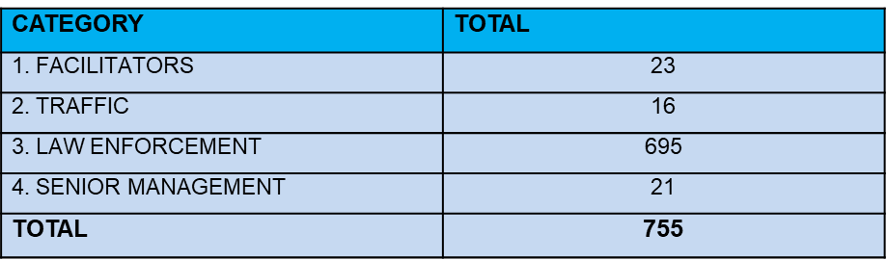
RPL PHASE 2
CATEGORIES
TRAINING VENUES AND COMMANDERS
VENUE | BELLVILLE CIVIC 1 | BELLVILLE CIVIC 2 | MUIZENBERG 1 | MUIZENBERG 2 | SENIOR MANAGEMENT ONLINE (SKYPE)
COMMAND | RI S. Reddy | Supt T. Nobongoza | PI J. Flowers | PI J. Flowers | I Patel
SUPERVISORS | Supt M. Ellman | Supt M. Ellman | Sgt M. Malan | Sgt M. Malan | M. Kanniah H. Van Der Merwe

Slide 16

SUMMARY
The RPL project is an initiative that aims to recognise and certify the prior learning and experience of traffic wardens, law enforcement officers and facilitators at training centres who have been working in road traffic law enforcement for at least three years.
The project is based on a rigorous methodology that involved application, workshop, portfolio and assessment phases. The project has been successful in providing orientation, guidance and support to the candidates, assessing and certifying their competence against the qualification outcomes.

